Slide 1
Ground Level Ozone
Philip Bradfield
GA - DC-DSI-3
10 February 2017

Slide 2
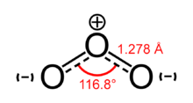
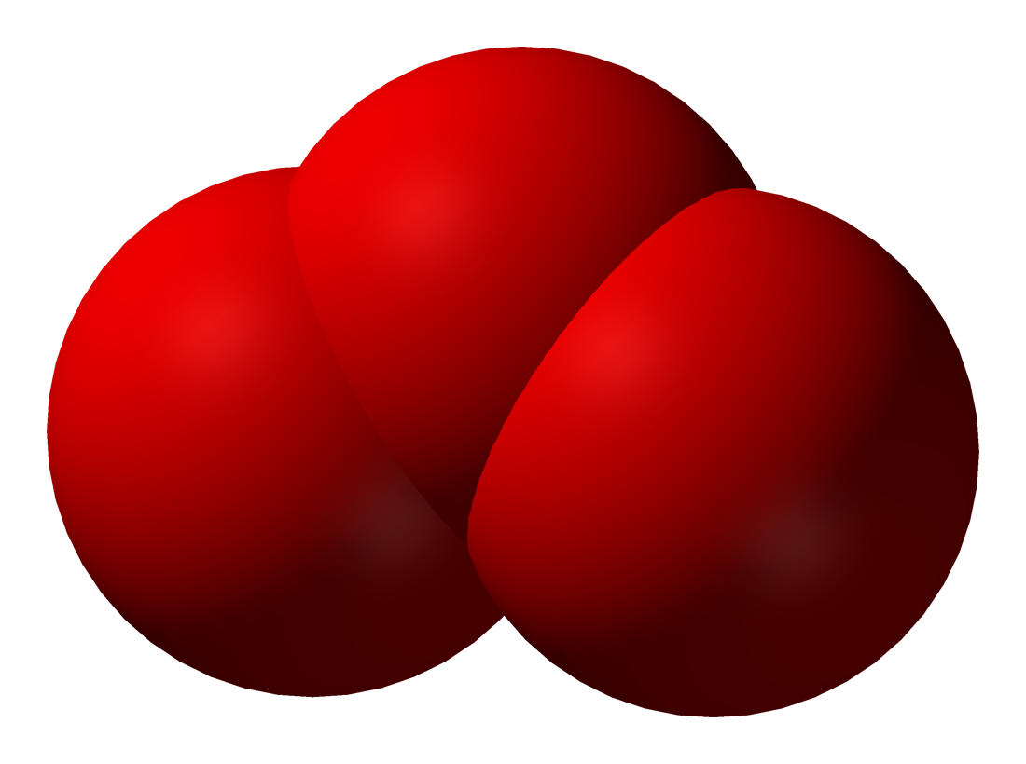
What is ozone?
A molecule made up of three oxygen atoms - O3
Agenda
What is ozone?
Why it matters.
Data
Modeling Approach
Modeling Results
Discussion
Future
Concluding Remarks

Slide 3
What is ozone?
Ground level ozone is an atmospheric
pollutant that is formed by by chemical
reactions between oxides of nitrogen (NOx)
and volatile organic compounds (VOC) in the presence of sunlight.
Emissions from industrial facilities and electric utilities, motor vehicle exhaust, gasoline vapors, and chemical solvents are some of the major sources of NOx and VOC.
Agenda
What is ozone?
Why it matters.
Data
Modeling Approach
Modeling Results
Discussion
Future
Concluding Remarks

Slide 4

What is ozone?
Agenda
What is ozone?
Why it matters.
Data
Modeling Approach
Modeling Results
Discussion
Future
Concluding Remarks
Ozone is one the of the major aspects of smog.

Slide 5
Why it matters.
Human Health
Breathing ozone can trigger a variety of health problems, particularly for children, the elderly, and people of all ages who have lung diseases such as asthma. Large long term studies have shown that ozone has significant effect on the mortality of those with diabetes and COPD Am J Respir Crit Care Med. “Long-Term Ozone Exposure and Mortality in a Large Prospective Study.” MC Turner, et al.
Agenda
What is ozone?
Why it matters.
Data
Modeling Approach
Modeling Results
Discussion
Future
Concluding Remarks

Slide 6
Why it matters.
Agriculture
Ground level ozone can also has harmful effects on sensitive vegetation and ecosystems. Numerous studies indicate that the monetary value of crop loss due to ozone will be many billions of dollars in the coming years. [J. of Exp. Botany, 1 Jan. 2012, “How is ozone reducing our food supply?”, S. Willinson et al.]
Greenhouse Gas
Ozone effects are regionalized due to its shorter life span, but it can have a heat trapping effect greater than carbon dioxide.
Wikipedia - ‘Ozone’
Agenda
What is ozone?
Why it matters.
Data
Modeling Approach
Modeling Results
Discussion
Future
Concluding Remarks

Slide 7
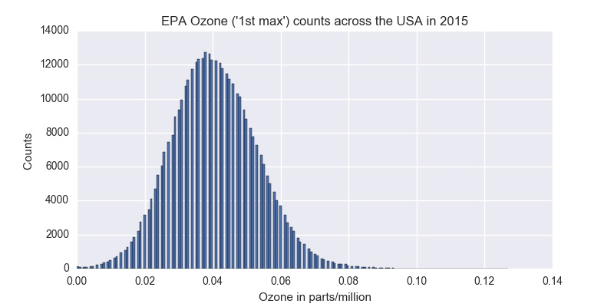
Data Source: EPA
Open source data at
www.epa.gov (for now??)
Ozone, VOC, NOX,
Sunlight levels ,
Temperature, Wind speed.
Agenda
What is ozone?
Why it matters.
Data
Modeling Approach
Modeling Results
Discussion
Future
Concluding Remarks

Slide 8
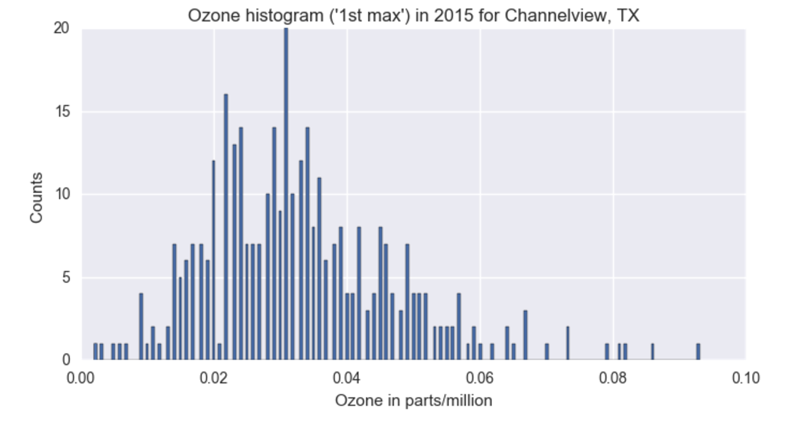
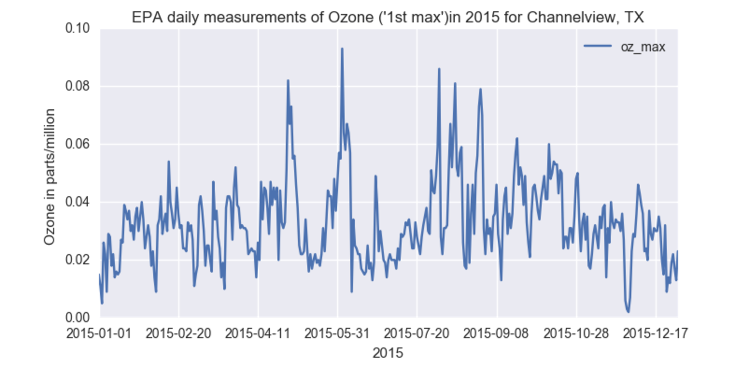
Data - Ozone Channelview TX
Agenda
What is ozone?
Why it matters.
Data
Modeling Approach
Modeling Results
Discussion
Future
Concluding Remarks

Slide 9
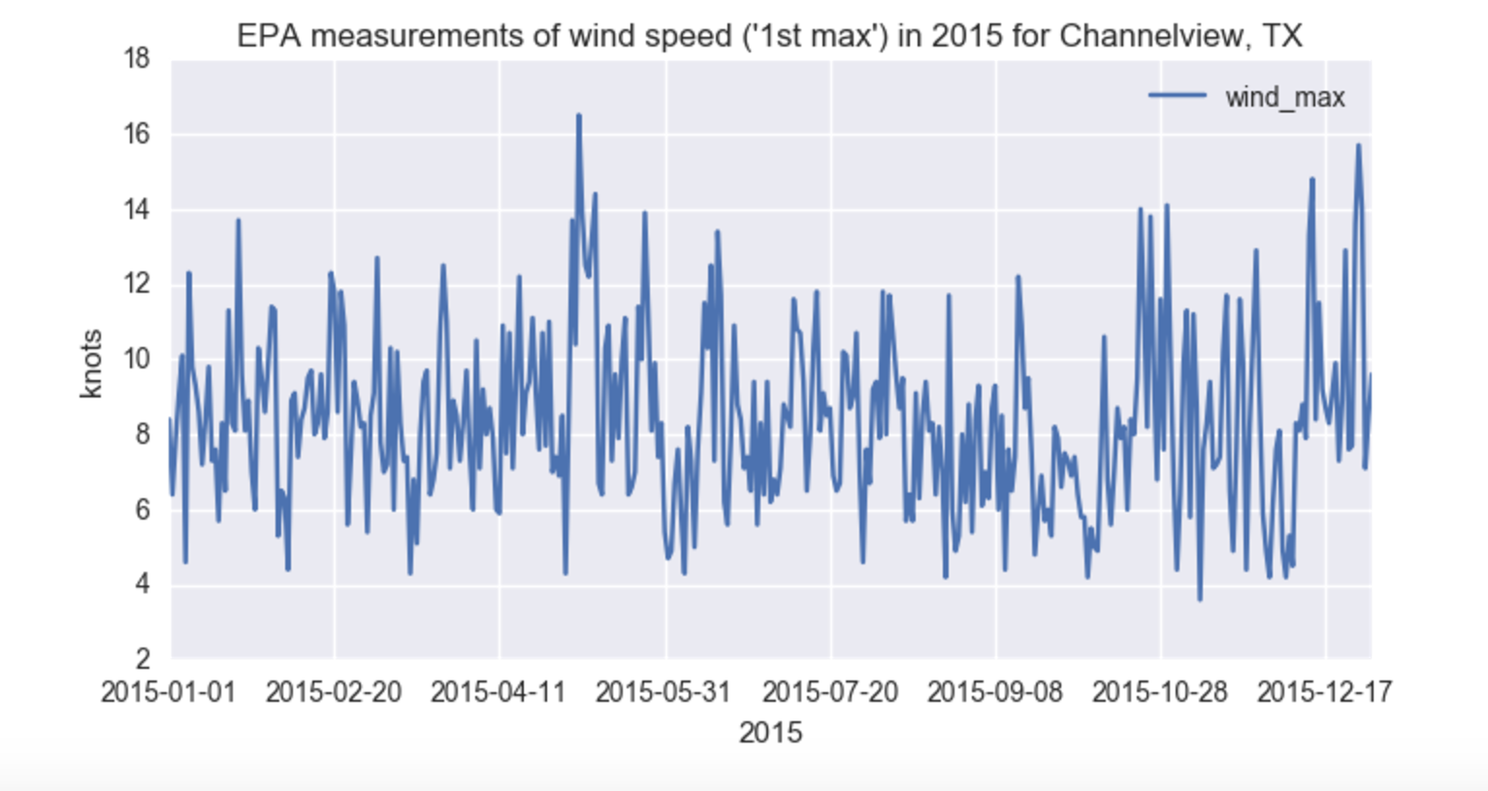
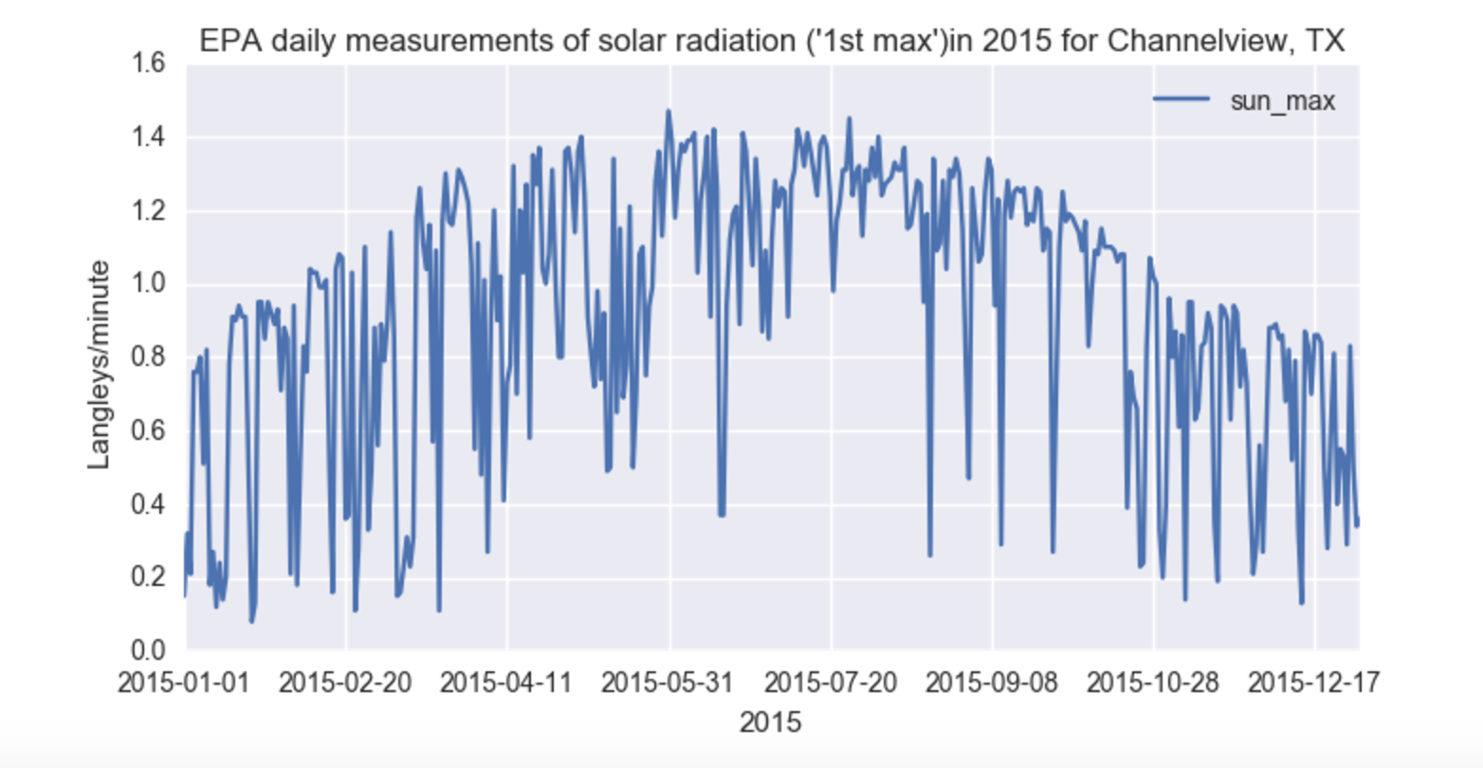
Data
Wind - Solar
Agenda
What is ozone?
Why it matters.
Data
Modeling Approach
Modeling Results
Discussion
Future
Concluding Remarks

Slide 10
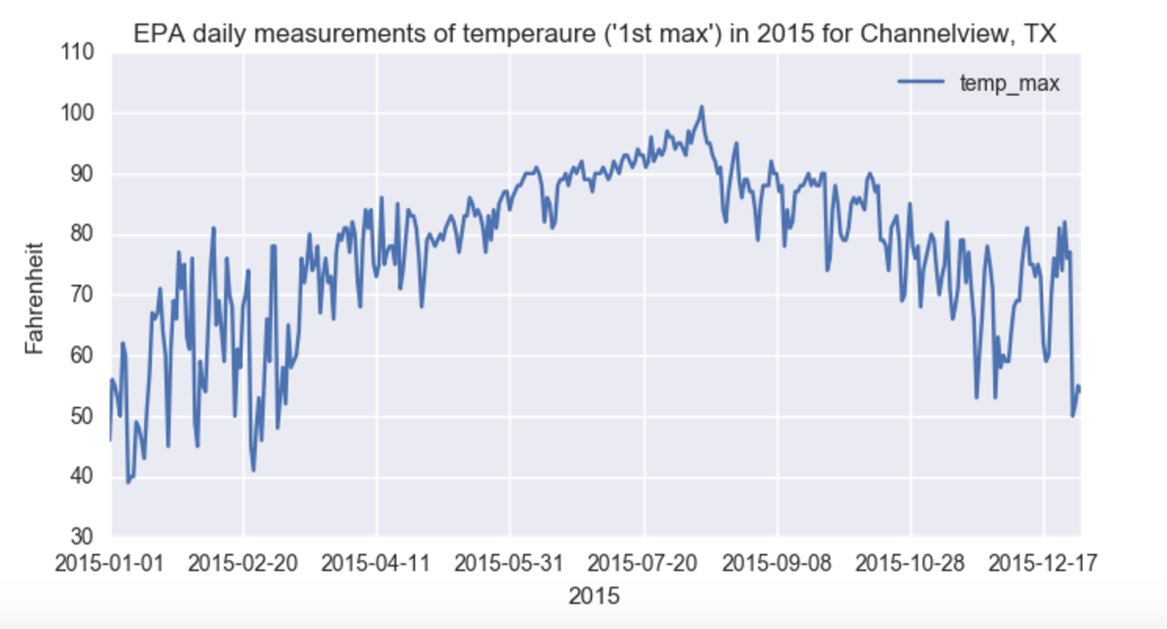
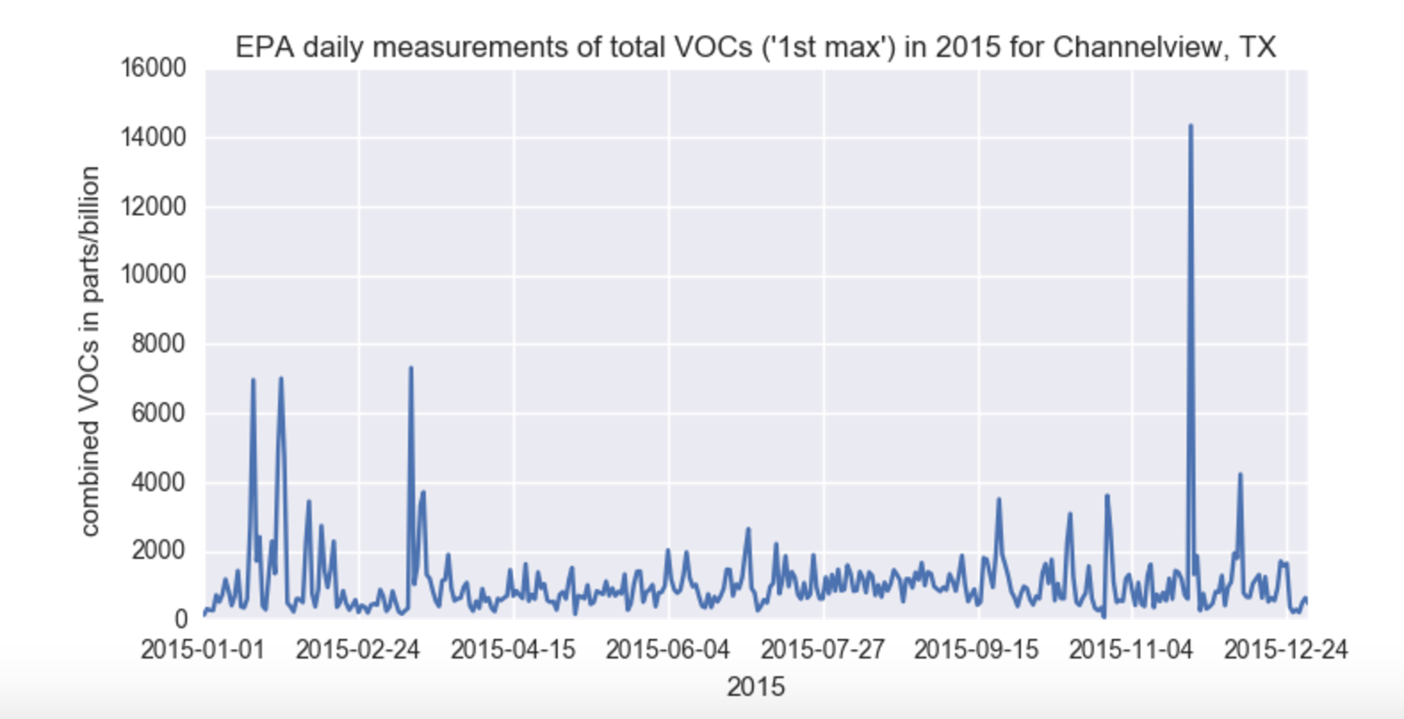
Data
Temp. & VOC
Agenda
What is ozone?
Why it matters.
Data
Modeling Approach
Modeling Results
Discussion
Future
Concluding Remarks

Slide 11
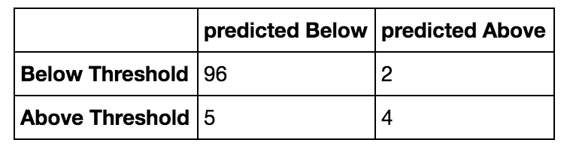
Modeling Approach
Investigated regressive and classification modeling.
A decision tree type classification model gave the best results.
One method of scoring how well a classification model is working is with a ‘confusion matrix.’ Simply put, a confusion matrix is a table that tells you how often the model was correct and how often it was wrong.
Agenda
What is ozone?
Why it matters.
Data
Modeling Approach
Modeling Results
Discussion
Future
Concluding Remarks

Slide 12
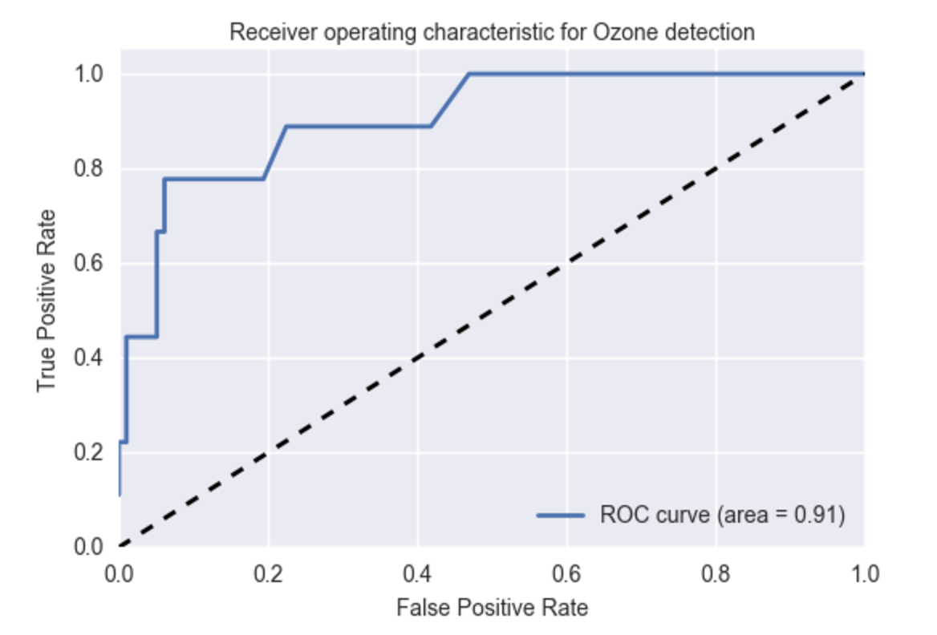
Modeling Results
ROC - AUC curve scoring of 0.91
(Receiver Operating Characteristic - Area Under Curve)
Agenda
What is ozone?
Why in matters.
Data
Modeling Approach
Modeling Results
Discussion
Future
Concluding Remarks

Slide 13
Modeling Results
A natural question for this type of modeling is which variable was the most important. Not surprisingly, the model indicated that sunlight was the most important or influential factor. That is not surprising since the it is a critical part of the formation of ozone.
According to the model, the second most influential input variable was the temperature.
Agenda
What is ozone?
Why in matters.
Data
Modeling Approach
Modeling Results
Discussion
Future
Concluding Remarks

Slide 14
Future
When complete data is available - model other locations.
Add other variables - humidity, barometric pressure?
Turn the program such into a teaching tool for high school students - environment, computers and (saving the best for last)...data science.
Weather modeling?
Agenda
What is ozone?
Why it matters.
Data
Modeling Approach
Modeling Results
Discussion
Future
Concluding Remarks

Slide 15
Concluding Remarks
Modeling something where weather is an important aspect of how it works has limitations.
People spend many years and millions of dollars building sophisticated computer models to predict weather patterns.
Additional research shows that the interaction that occurs to form ozone from VOC and NOX is not a simple one. A more sophisticated (non-weather
modeling) model could be used - neural network?
Agenda
What is ozone?
Why it matters.
Data
Modeling Approach
Modeling Results
Discussion
Future
Concluding Remarks

Slide 16
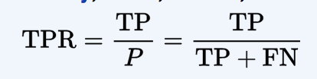

ROC-AUC explanation
ROC - AUC curve explanation
Agenda
What is Ozone?
Why it matters.
Data
Modeling Approach
Modeling Results
Discussion
Future
Concluding Remarks

Slide 17
“Extra Trees”
explanation
“Extra Trees - “Extreme Random Forest” - a type of decision tree classifier
Decision Tree classification - a machine learning approach that is not affected by scaling and various other transformations of feature values, is robust to inclusion of irrelevant features, and easily understood. Minus side - they can ‘overfit’ and can be susceptible to high variance
Random Forest - average over many trees with a random subset of the features - reduce the variance aspect with a small increase in bias. Improves performance though you have some loss of interpretability
‘Bagging’ - repeatedly (B times) selecting a random sample with replacement of the training set and fitting trees to these samples and aggregating the results.
This bootstrapping procedure leads to better model performance because it decreases the variance of the model, without increasing the bias.
‘Extreme’ - at each candidate split in the learning process, a random subset of the features is used (Random Forest) AND for each feature under consideration, a random value is selected for the split.
Agenda
What is Ozone?
Why it matters.
Data
Modeling Approach
Modeling Results
Discussion
Future
Concluding Remarks

